Slide 1
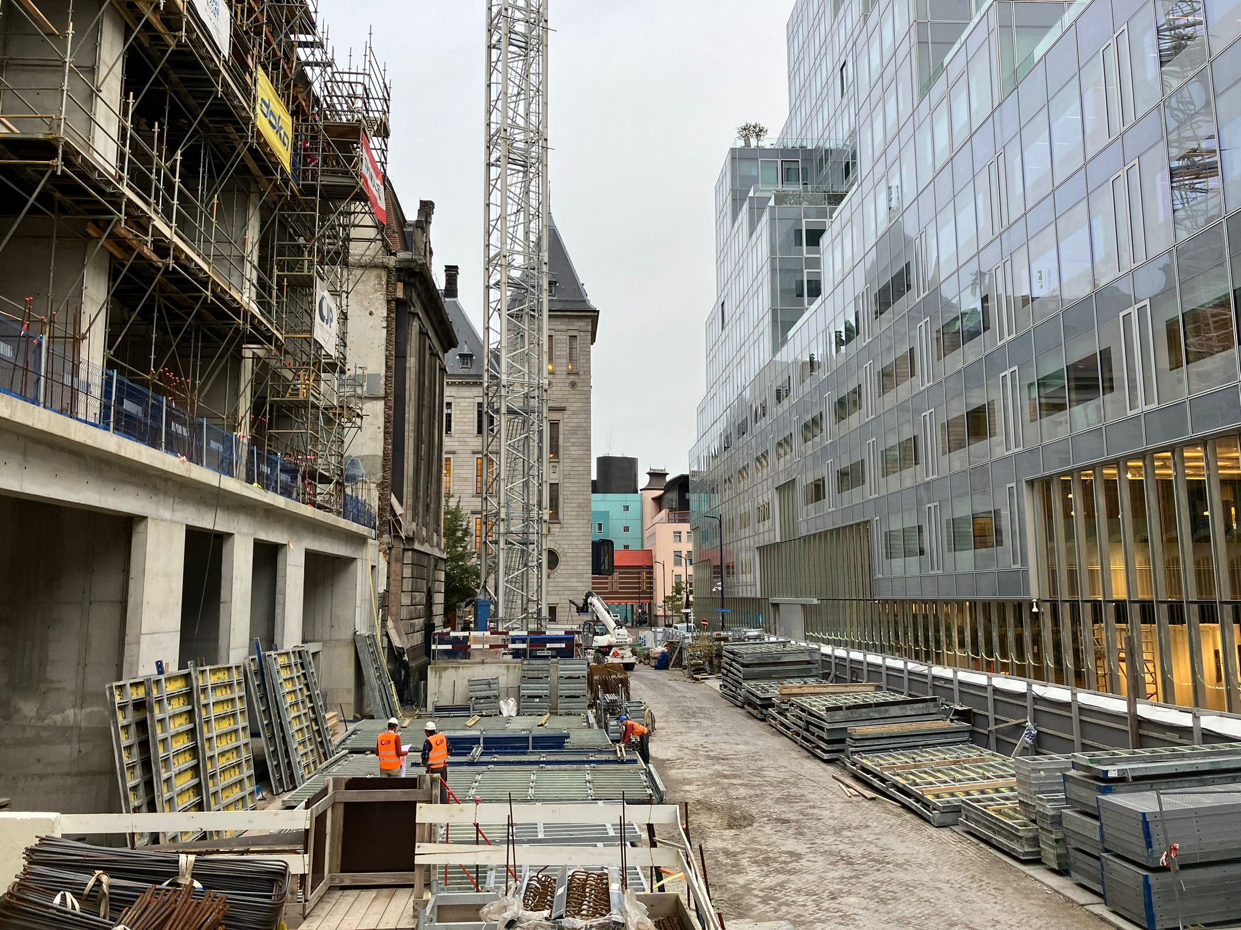
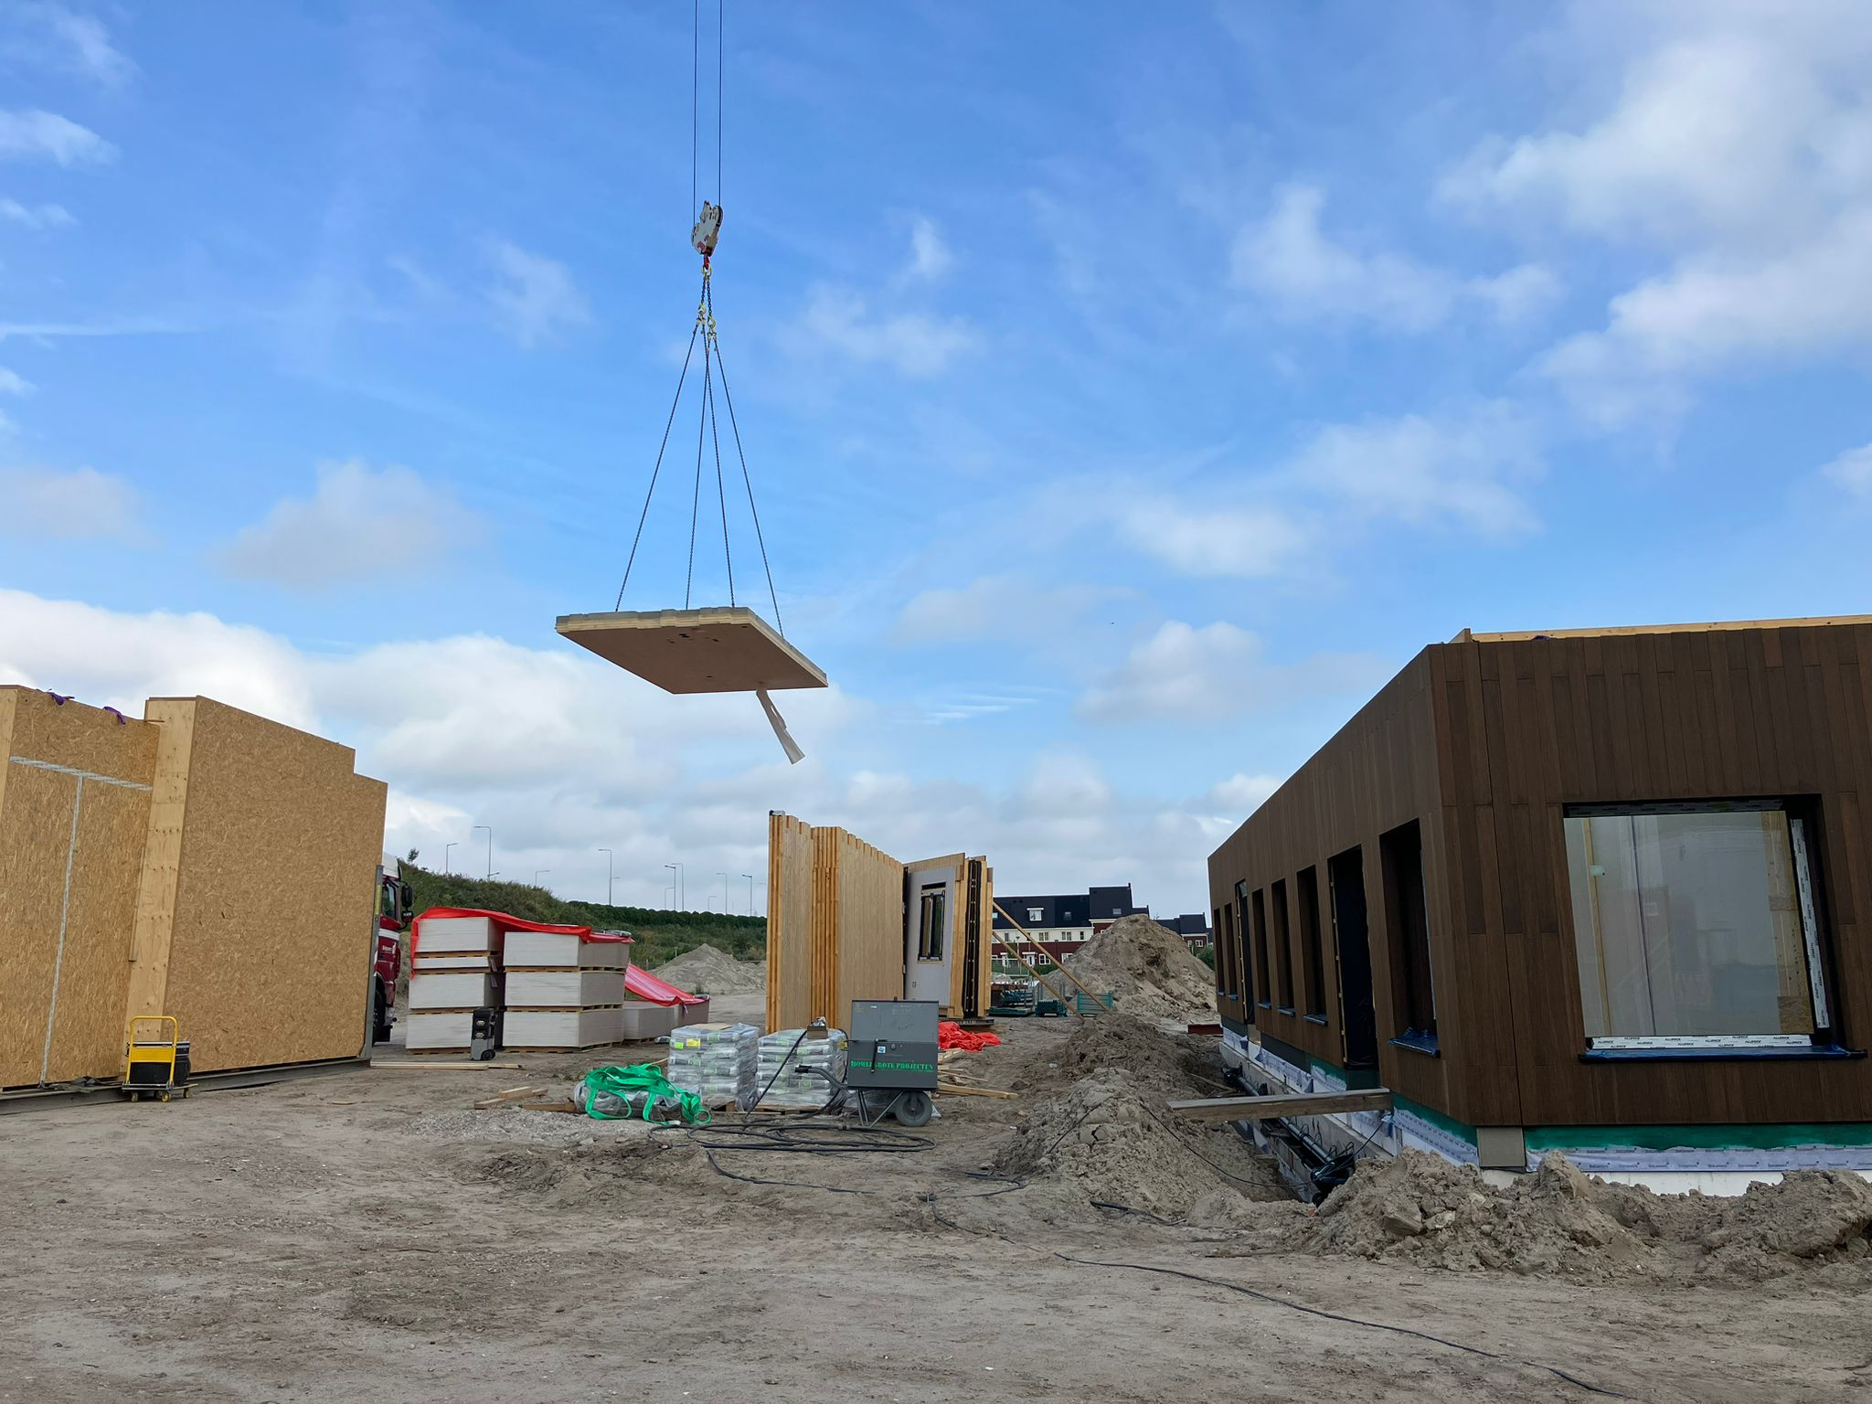
Senseable Construction
Measuring Air Quality in the G4 - WP3.4
JULIANE FRY, TITUS VENVERLOO, GABRIEL ARANDA MORALES, MINY RAJIV WAGENINGEN UNIVERSITY | MIT SENSEABLE AMSTERDAM LAB | AMS-INSTITUTE
21-10-2023

Slide 2
Research Set-Up

Slide 3
Research Motivation

Slide 4
Research Goals
Measure the concentration of air pollutants (PM2.5, NO2, UFP, BC), with the goals of: 1. Understanding the average ambient concentrations for different construction activities 2. Assessing the concentration reduction opportunities of bio-based and electric building methods

Slide 5
Research Methodology
Multiple case-study design Step 1. Calibrating sensors Step 2. Measuring the air pollutants with 3 devices
Step 3. Observing activities on-site Step 4. Analysing in R

Slide 6
Sampling Process
Measurement frequency: 5 measurements per site, 10 total. Of which 1 day without activity.
Points of measurement: - Trucks - Main activities including crane
Time of measurement: early mornings ~6.30-11.30

Slide 7
-- Insert slide to show measurement locations on-site --

Slide 8
Literature

Slide 9
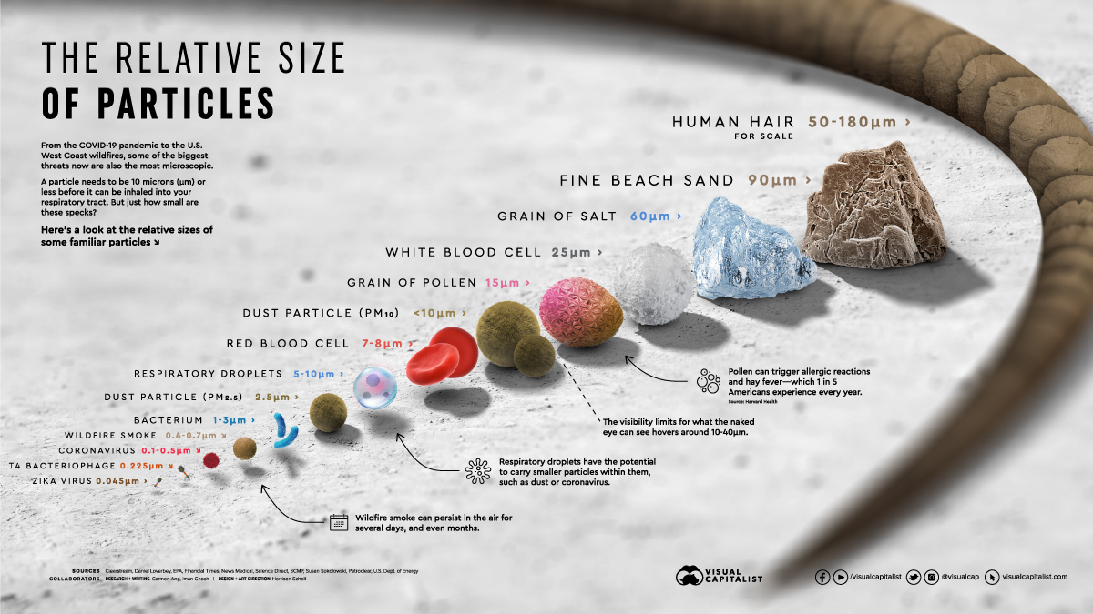
Introducing the air pollutants
UFP: Ultrafine Particulate Matter: - Good indicator of diesel sources - Diameter < 0.1 micrometres - Most concentrated at the sources - No standards by WHO, not a lot of research done.
BC: Black Carbon particulate matter: - Incompletely burned fuel particles - Another good diesel marker, especially for older or less well-controlled diesel equipment.
PM2.5: - Diameter < 2.5 micrometers - Diverse sources in an urban environment - Longer lived than UFP.
PM10: - Diameter < 10 micrometers. - Construction activities generating dust.
NO2: - Currently of large interest in the Netherlands - From diesel, gasoline fueled engines and generators
https://www.visualcapitalist.com/wp-content/uploads/2020/10/RelativeSizeofParticles-Infographic-1200px_v8.jpg

Slide 10
Research gap

Slide 11
Case studies

Slide 12
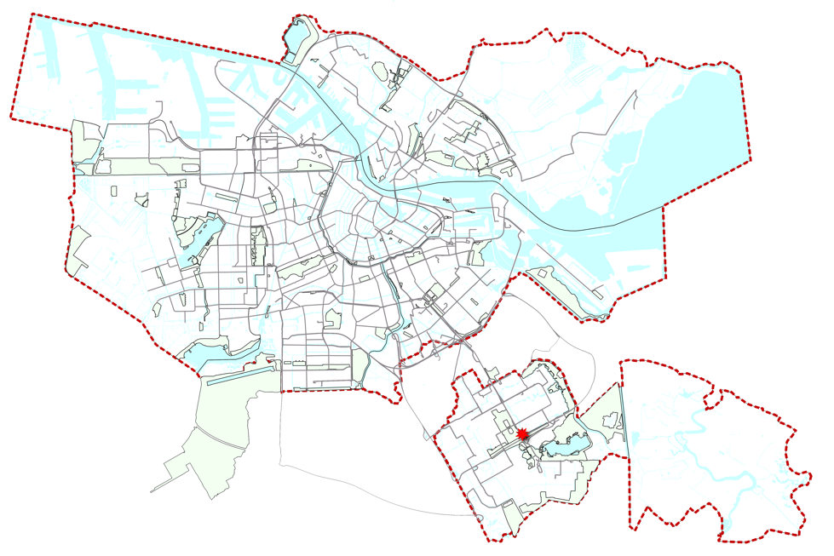
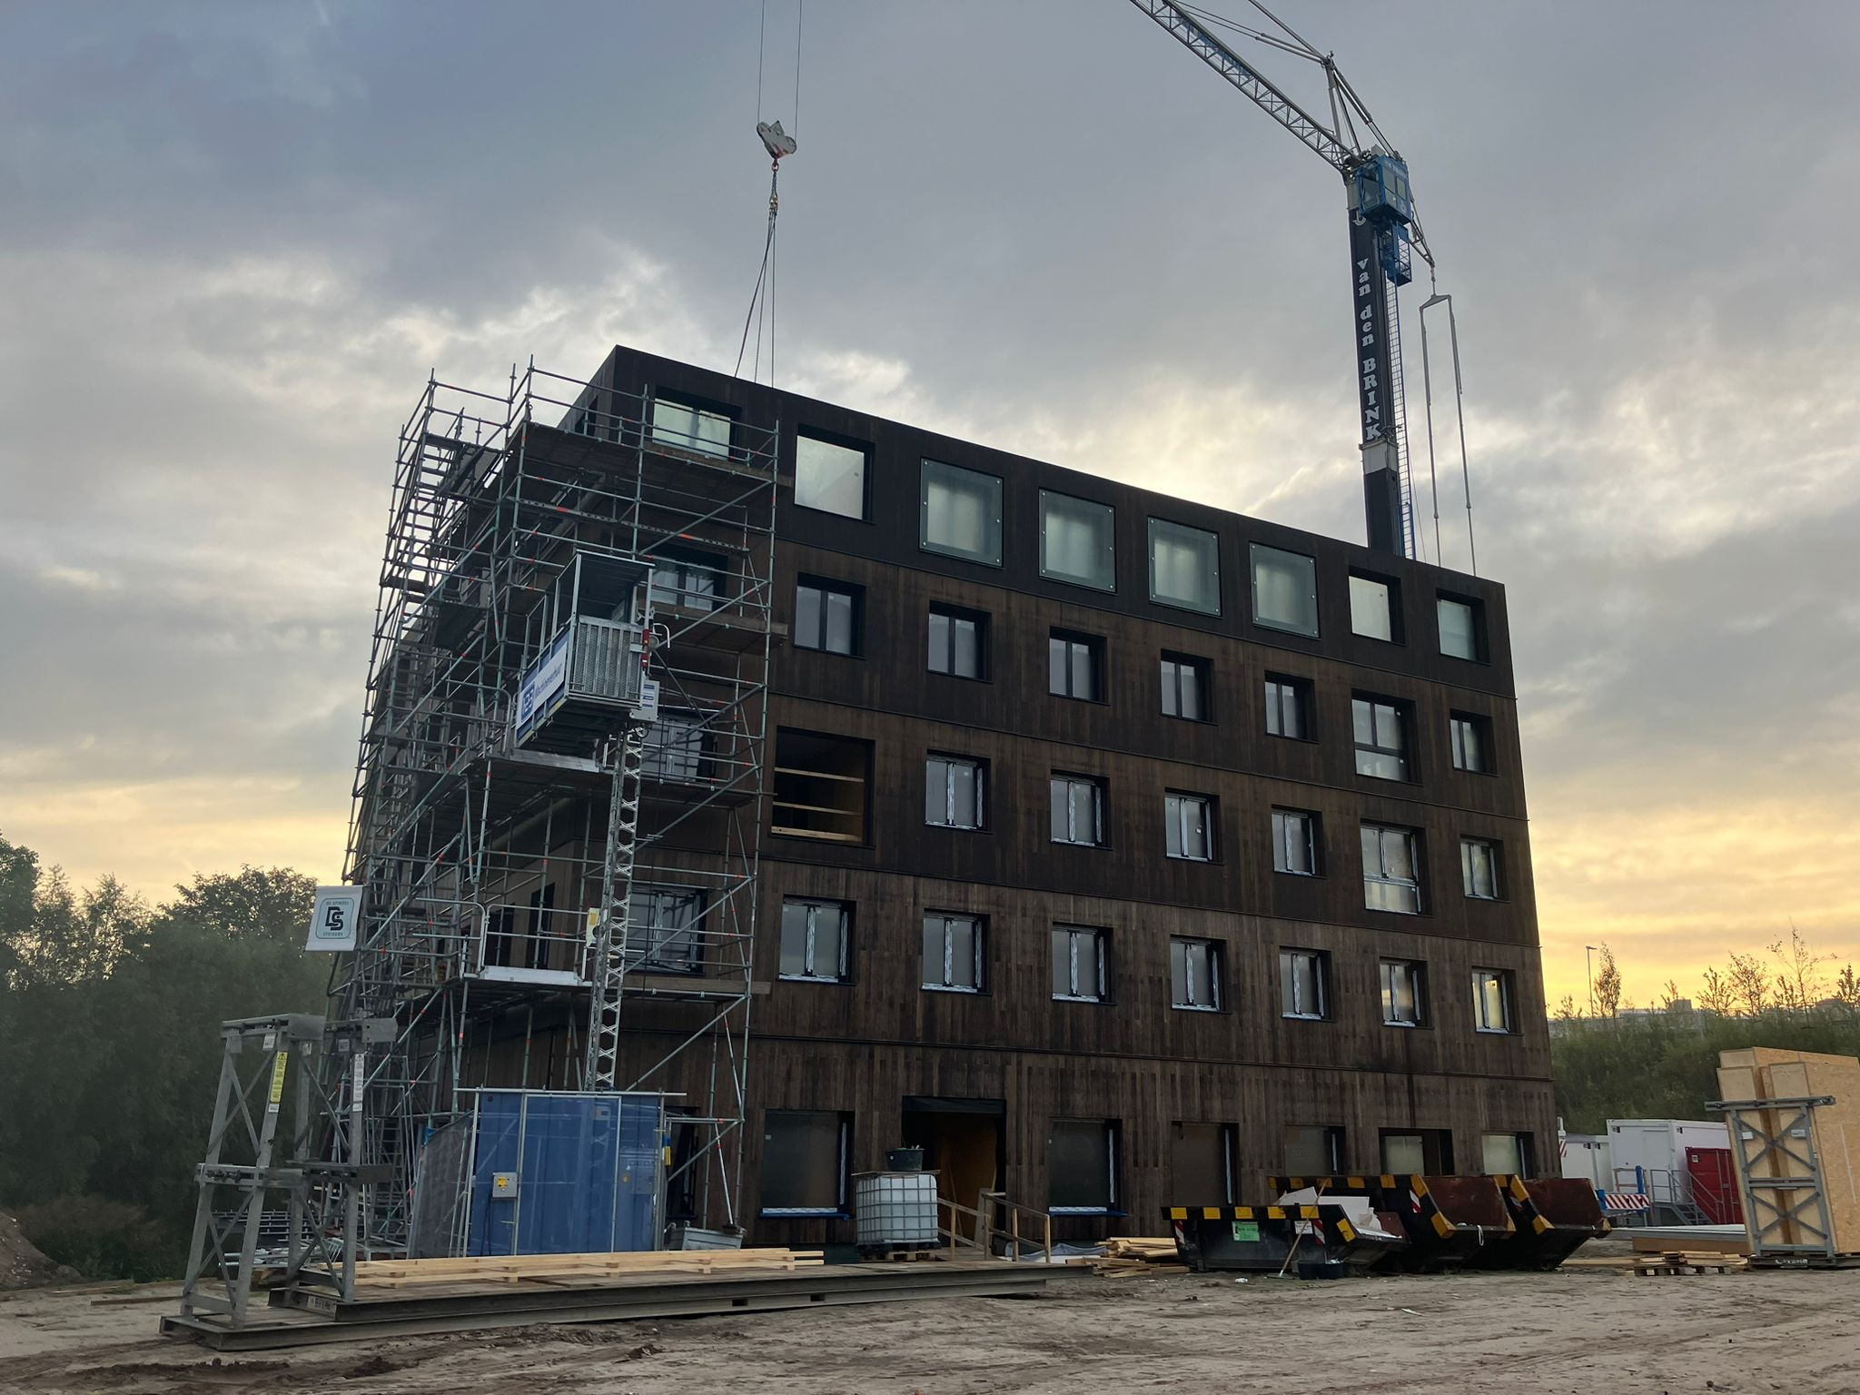
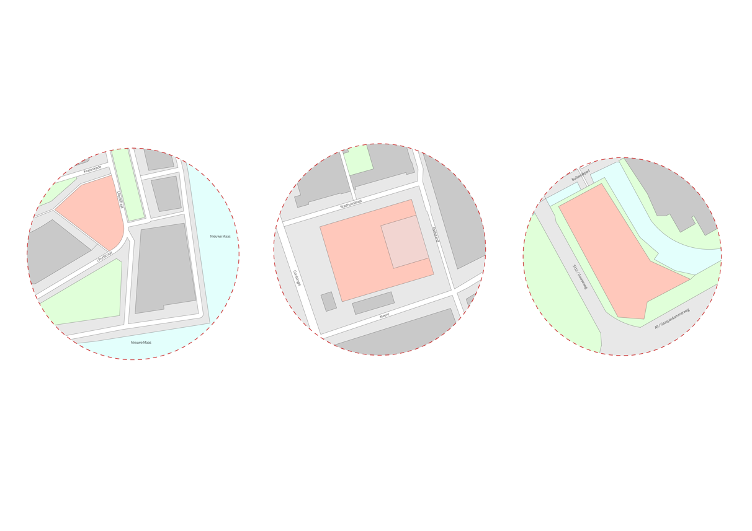
Case study 1: Switi Amsterdam
Cross laminated timber (CLT)
Switi, located in Amsterdam, Zuid-Oost, consists of a mid-rise apartment building (8 stories), and various single-family homes. Built entirely with pre-fab CLT.
Expected dates: June 2023 – November 2023.

Slide 13
Case overview Switi
Cross laminated timber (CLT)
Switi is a residential middle-rise building made of wood. It is located in Amsterdam South-East.
Building phase: During the period of measuring, they were building the 1-5th floor of the building. Start date: June 2023, Expected end-date: November 2023.
Activities include (1-2) weekly delivery of materials, drilling and using a diesel-agregated crane for carrying and placing materials.

Slide 14
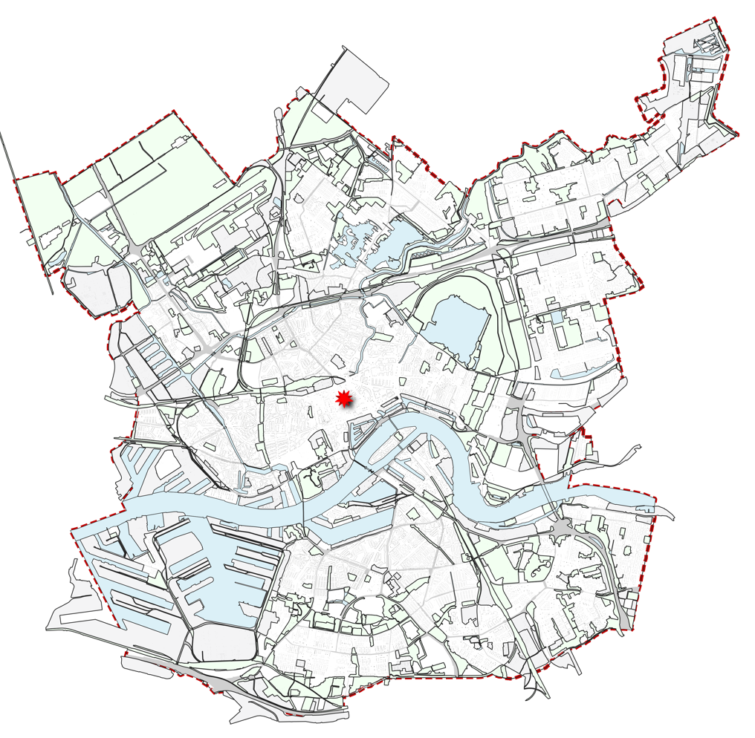
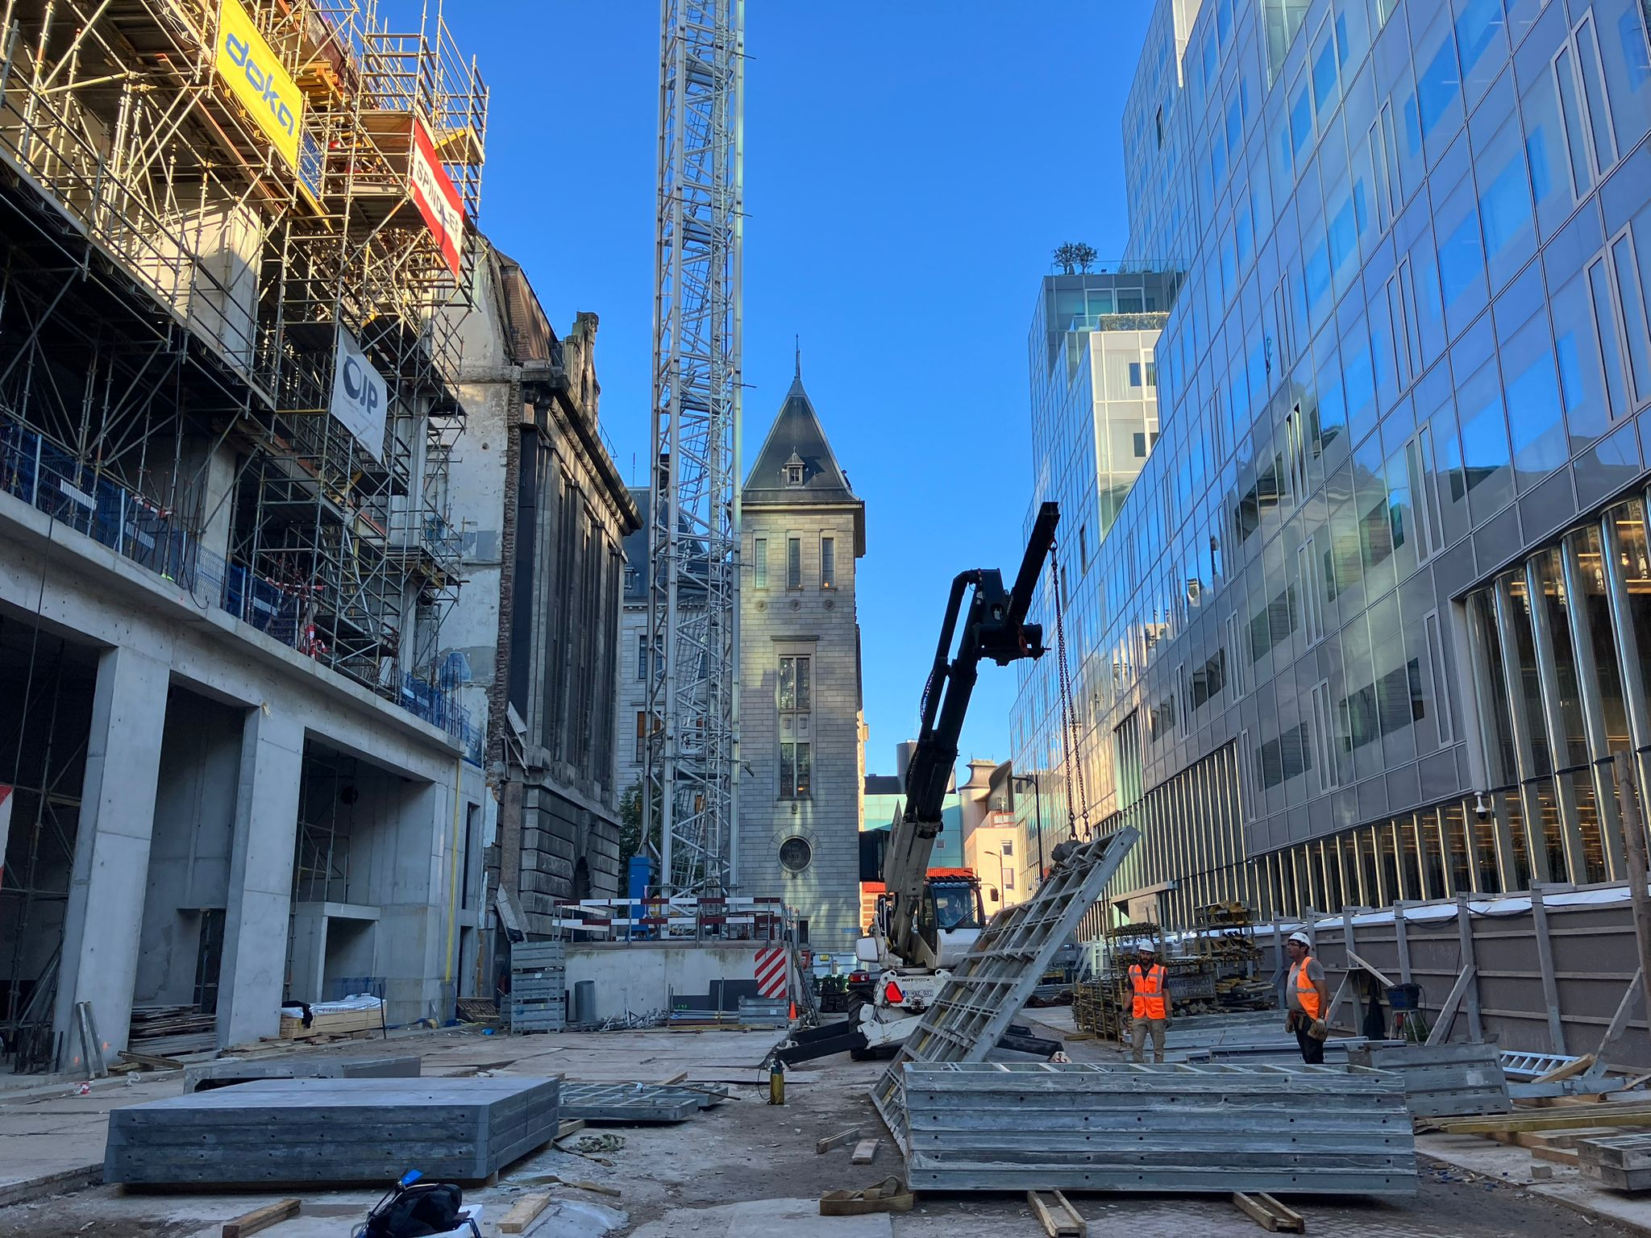
Case study 2: Post Rotterdam Conventional construction, with electric crane
The Post Rotterdam project located in the city centre of Rotterdam. It is a mixed high-rise building built with a conventional steel and concrete structure.
Expected dates: 2022 -January 2025.

Slide 15
Case overview POST
Conventional construction, with electric crane
POST is a multifunctional concept with hotel, appartments, bars, restaurants and retail. It is located in the middel of the city centre of Rotterdam, next to the coolsingel and the city hall.
Building phase: During the period of measuring, they were building the 2-5th floor of the building. Start-date: 2022, expected end-date: January 2025.
Activities include cement mixing, driving up and down with a small truck, drilling and using an electric crane for carrying and placing materials.

Slide 16
Results

Slide 17
Overview Table
Min | 1st Quartile | Median | Mean | 3rd Quartil | Max
1094 | 8363 | 10688 | 12026 | 14730 | 338539

Slide 18
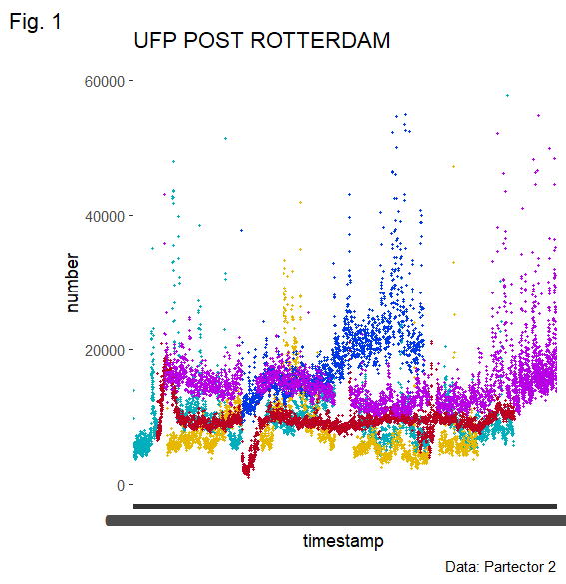
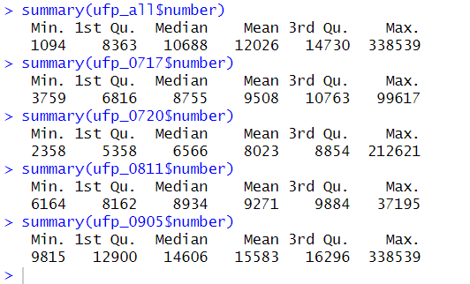
Overview UFP – POST
Min | 1st Quartile | Median | Mean | 3rd Quartil | Max
1094 | 8363 | 10688 | 12026 | 14730 | 338539
Notes:
Chop up in chunks per location. Look at break periods!!

Slide 19
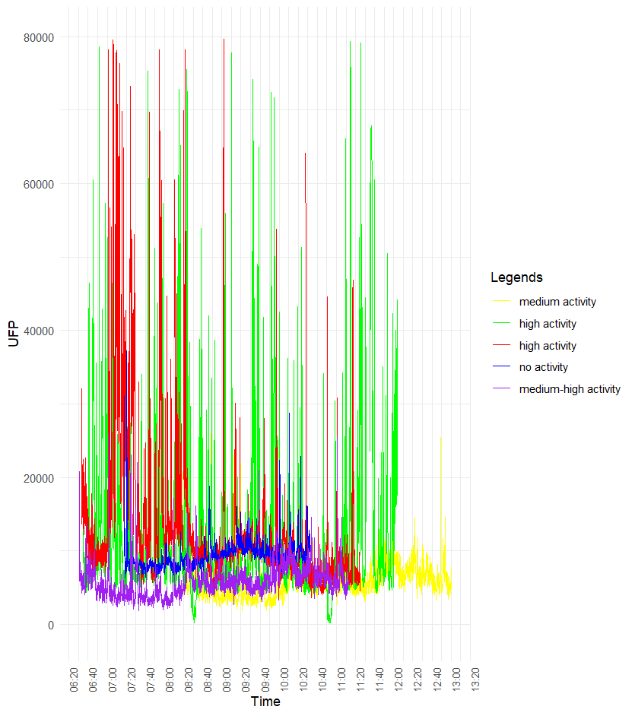
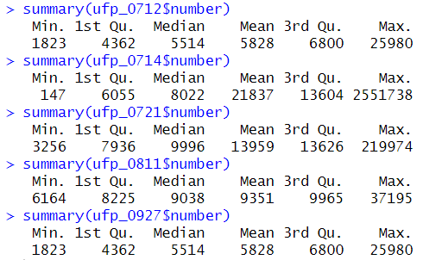
Overview UFP – Switi
Min | 1st Quartile | Median | Mean | 3rd Quartil | Max
1094 | 8363 | 10688 | 12026 | 14730 | 338539
Notes:
Chop up in chunks per location. Look at break periods!!

Slide 20
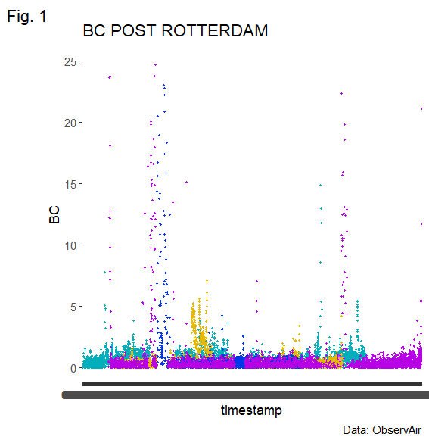
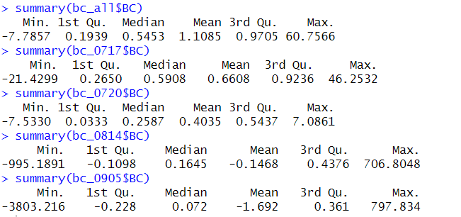
Overview BC – POST
Notes:
Zoom in on the spikes. Align ultrafines + BC temporaliy (see if there are spikes).

Slide 21
Overview NO2 – POST
Notes:
Zoom in on the spikes. Align ultrafines + BC temporaliy (see if there are spikes).

Slide 22
Overview PM25 – POST
Notes:
Zoom in on the spikes. Align ultrafines + BC temporaliy (see if there are spikes).

Slide 23
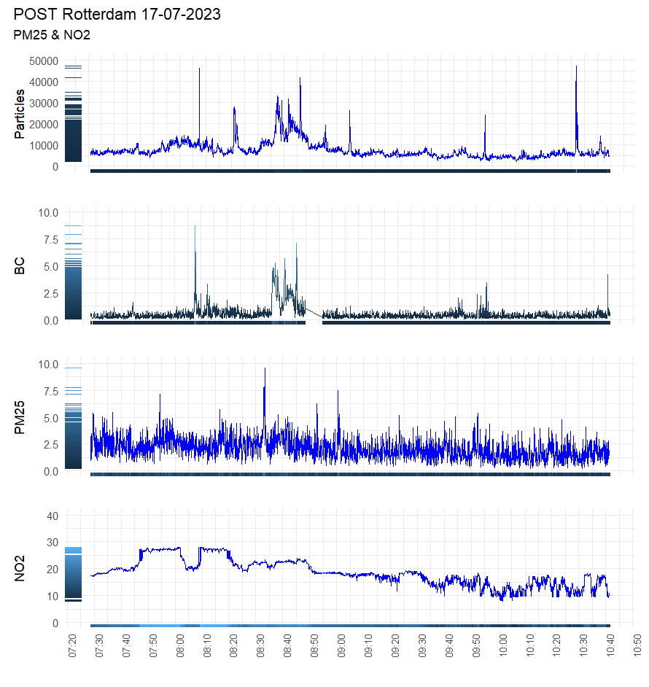
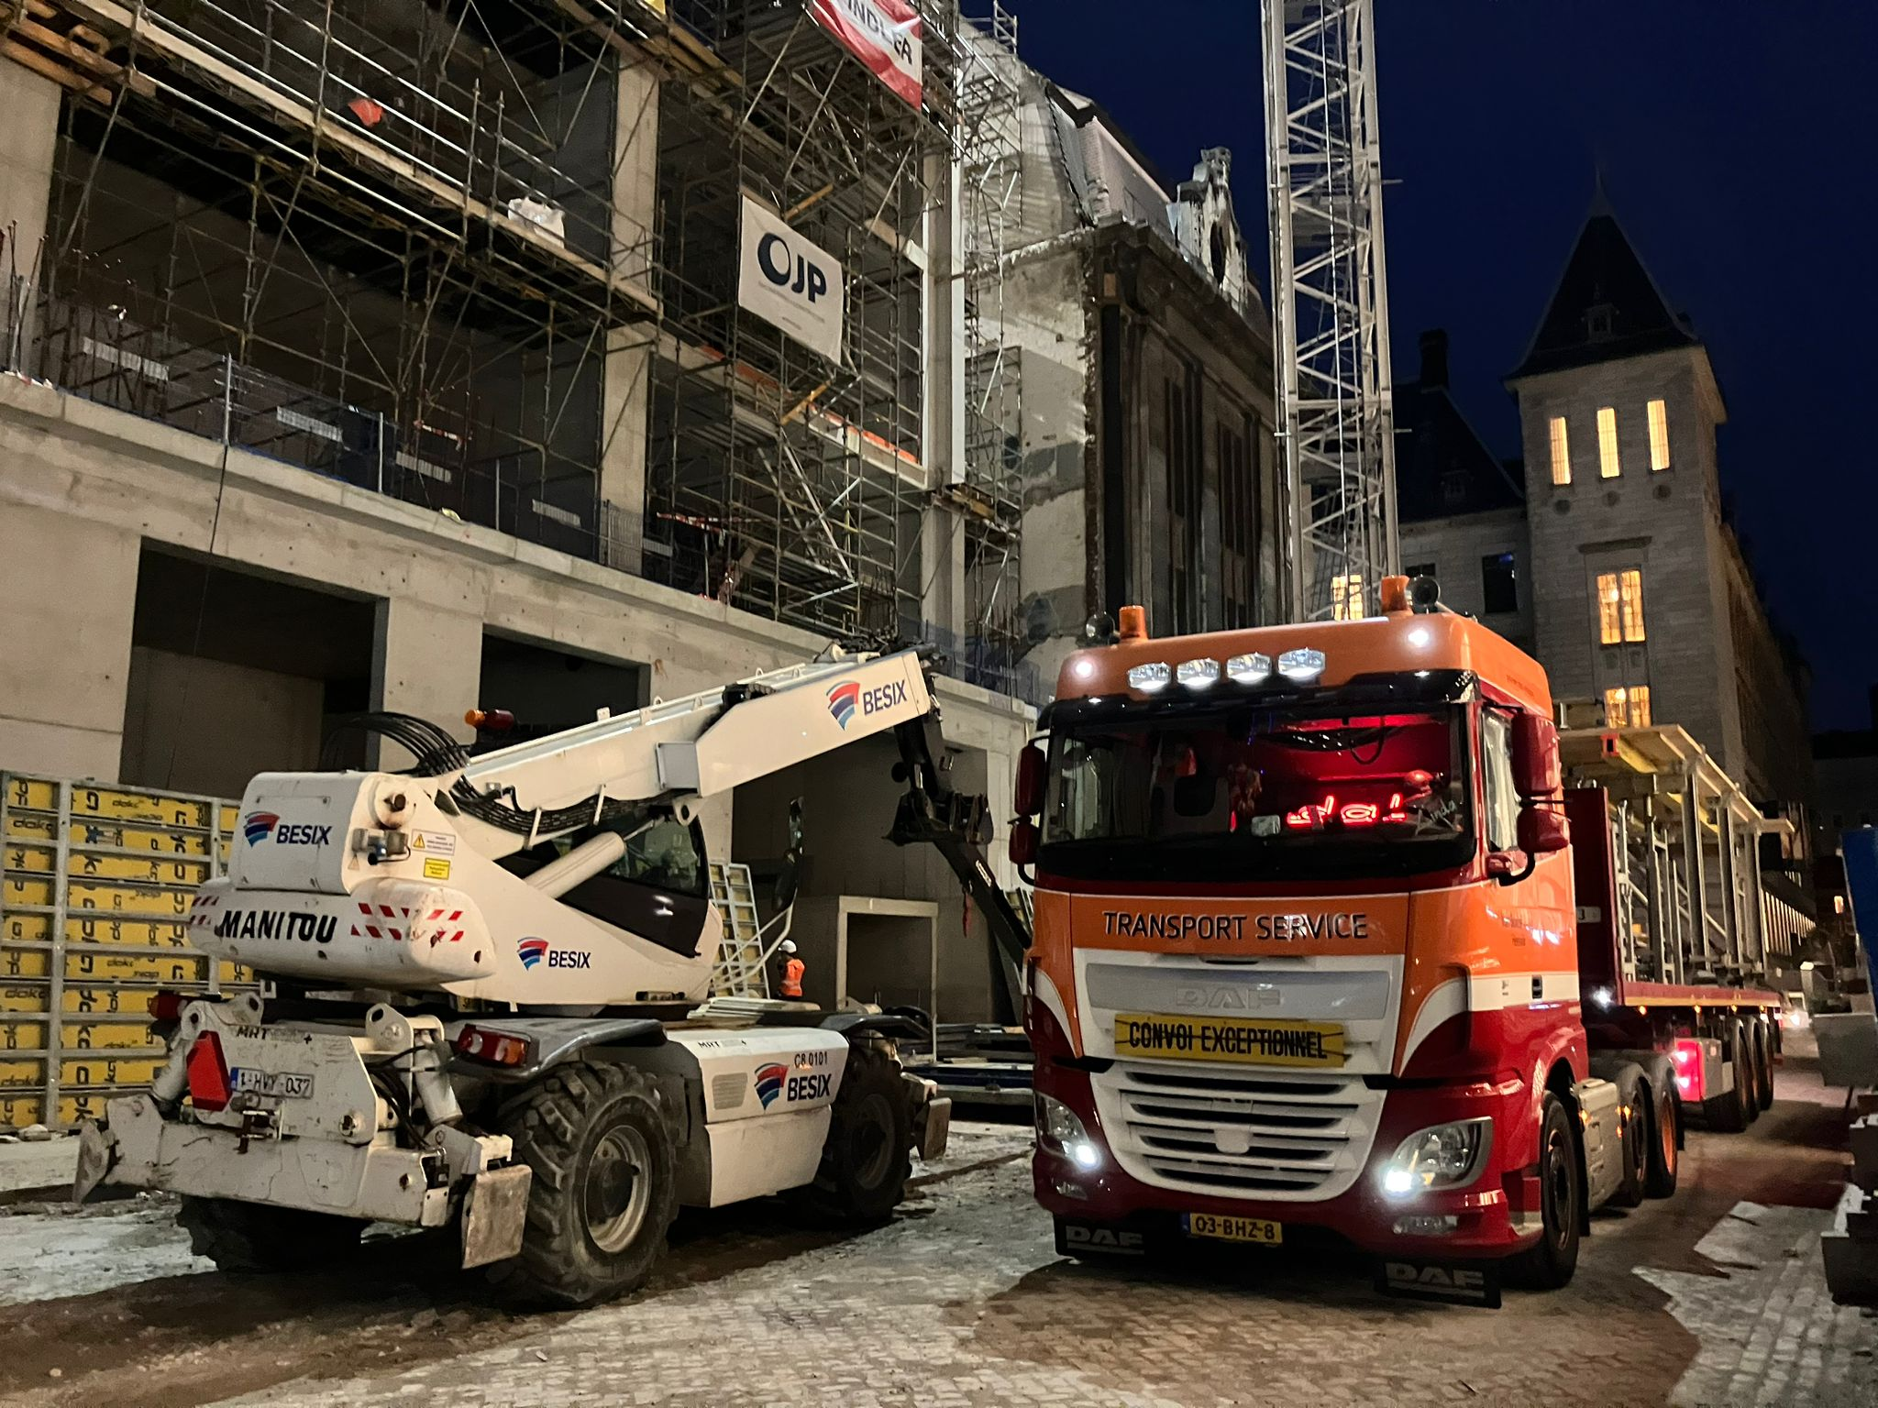
Preliminary results a.
Relative pollution contribution from construction sites

Slide 24
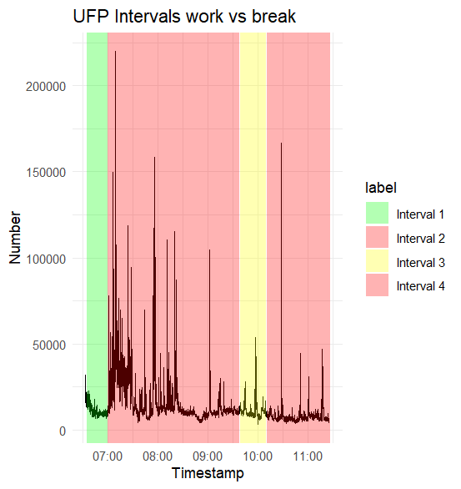
Preliminary results b.
Relative pollution contribution of construction sites:
Activity versus Non-activity
 | Start | End | mean_value_UFP | mean_value_BC
1 | 2023-07-21 08:35:00 | 2023-07-21 09:00:00 | 10.778 | 1,202
2 | 2023-07-21 09:00:00 | 2023-07-21 11:38:00 | 17.725 | 3,653
3 | 2023-07-21 11:39:00 | 2023-07-21 12:10:00 | 10.956 | 1,461
4 | 2023-07-21 12:11:00 | 2023-07-21 13:27:00 | 8.107 | 1,036

Slide 25
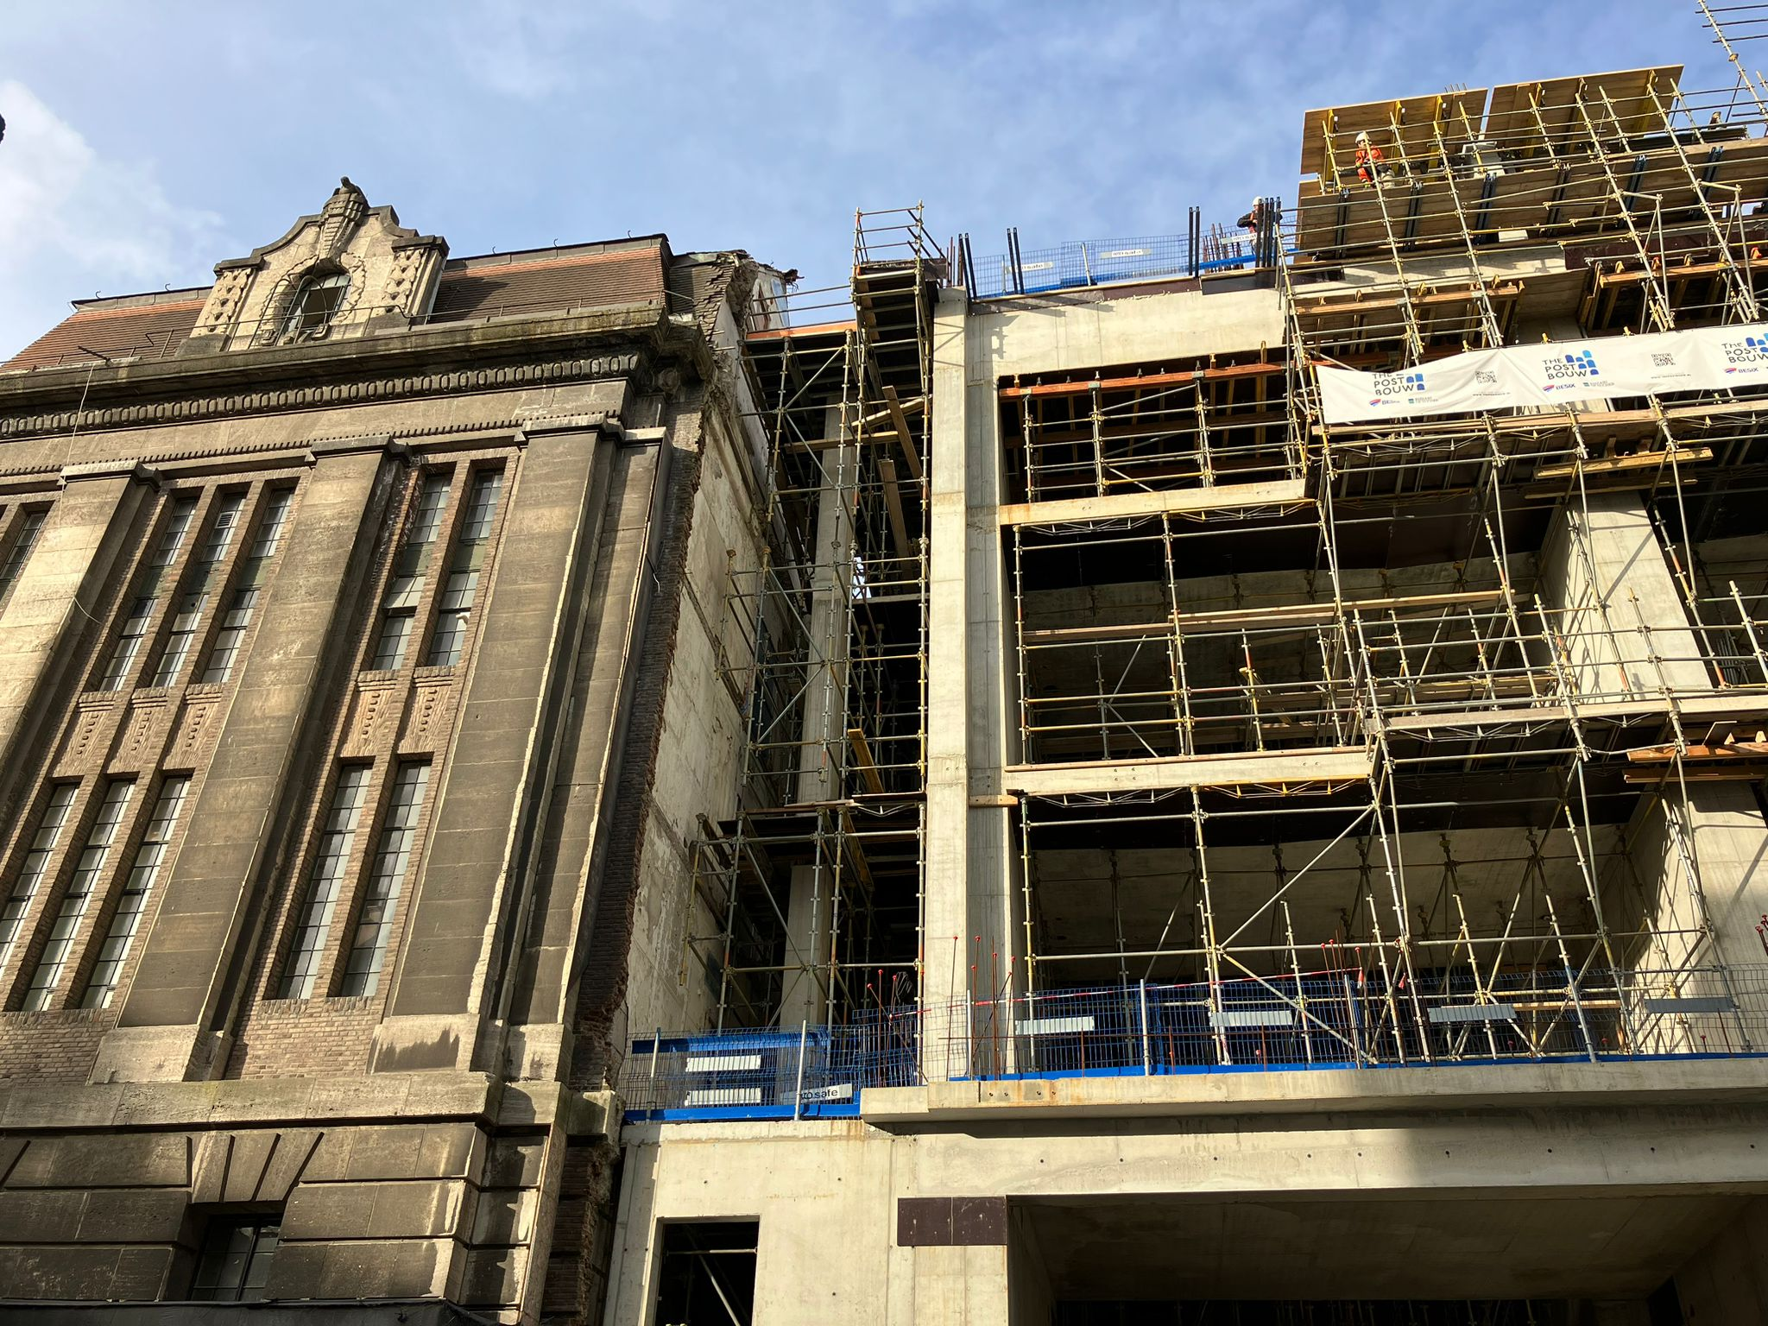
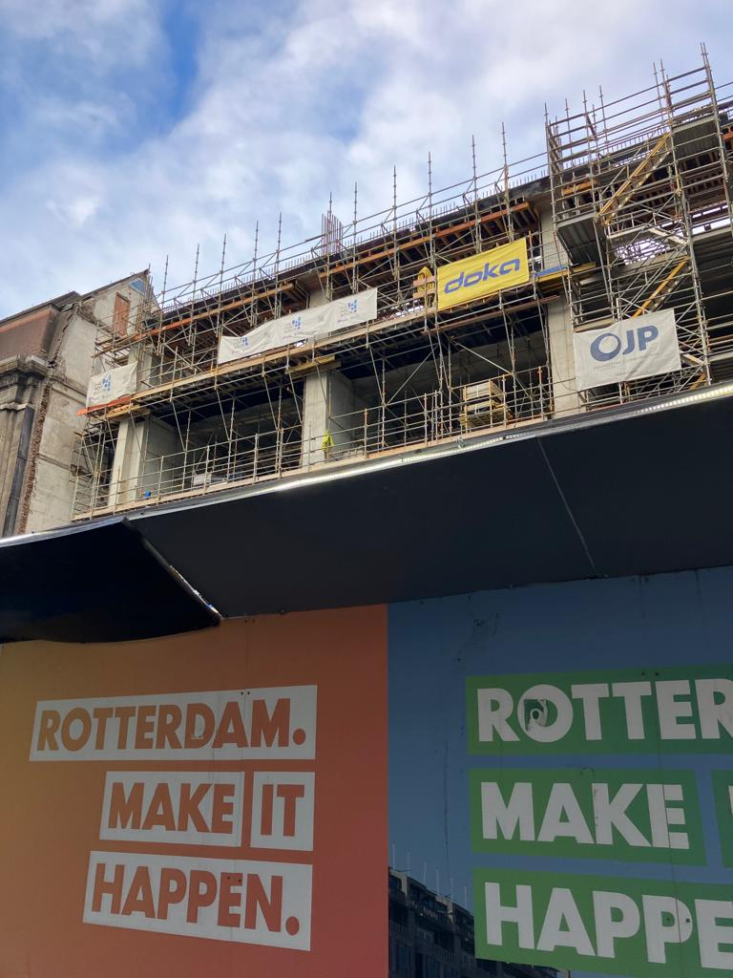
Preliminary results c.
The fence changes the results significately
Who do we expose, who do we protect?

Slide 26
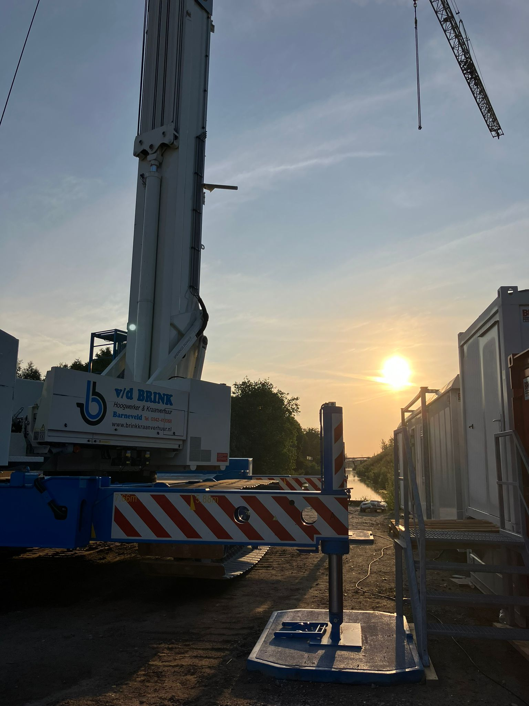
Preliminary results d.
Wood seems to help, BUT:
The importance of an electric crane
Practical concerns: Access to wood. Costs.

Slide 27
